Slide 1
Beyond Basics for iPhone / Android Smartphones
BLOCKING
repeat callers, unwanted marketing texts!
Finding & listening to
PODCASTS

Slide 2
A WORD ABOUT NOTE TAKING
Add a title to your note
Write down what to do first, where to look
Write when to Click and what to Click on
For the next step INDENT, again include what to Click
Continue indenting
When it’s time to get out of screens, use < or ←
Try following your instructions before leaving

Slide 3
Note Taking EXAMPLE – Getting Apps
  Open the App Store or Google Play Store by clicking on icon
    In App / Play Store click at the bottom on SEARCH
      In Search look up to top and find gray Search area and click in it
        Type what you are search for – Google Podcasts and at the bottom of screen tap Search
    On next screen, look through the list of search results until you see the App
      Click on the name of App – you can now read more about the App or decide to GET it
        Look at the bottom for a popup and Click Install
          On an iPhone you’re asked to enter Apple ID password and click Sign In
          Watch above on screen for the circle spinning
        When it is done Installing you will see a new button OPEN , click on it
  Your screen will change and you will be in the Google Podcasts App for the first time.
    Answer the questions, choosing from the next screens (you only do this once)

Slide 4

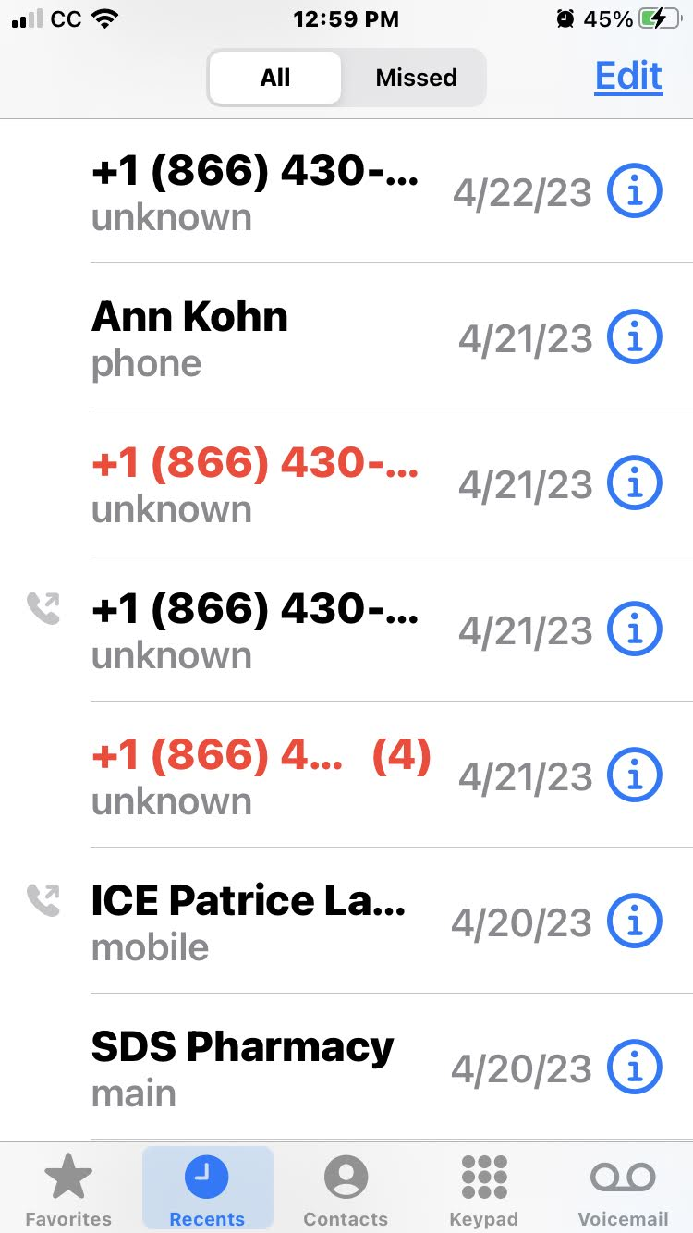
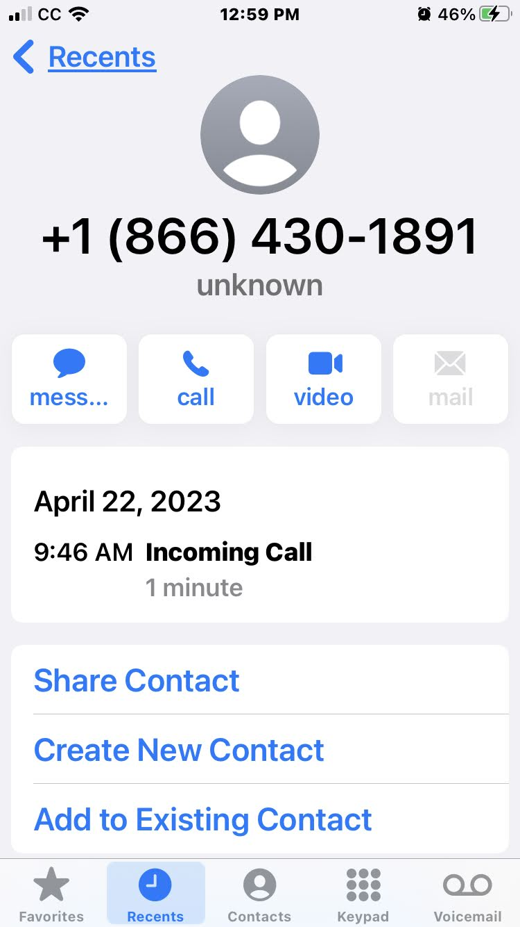
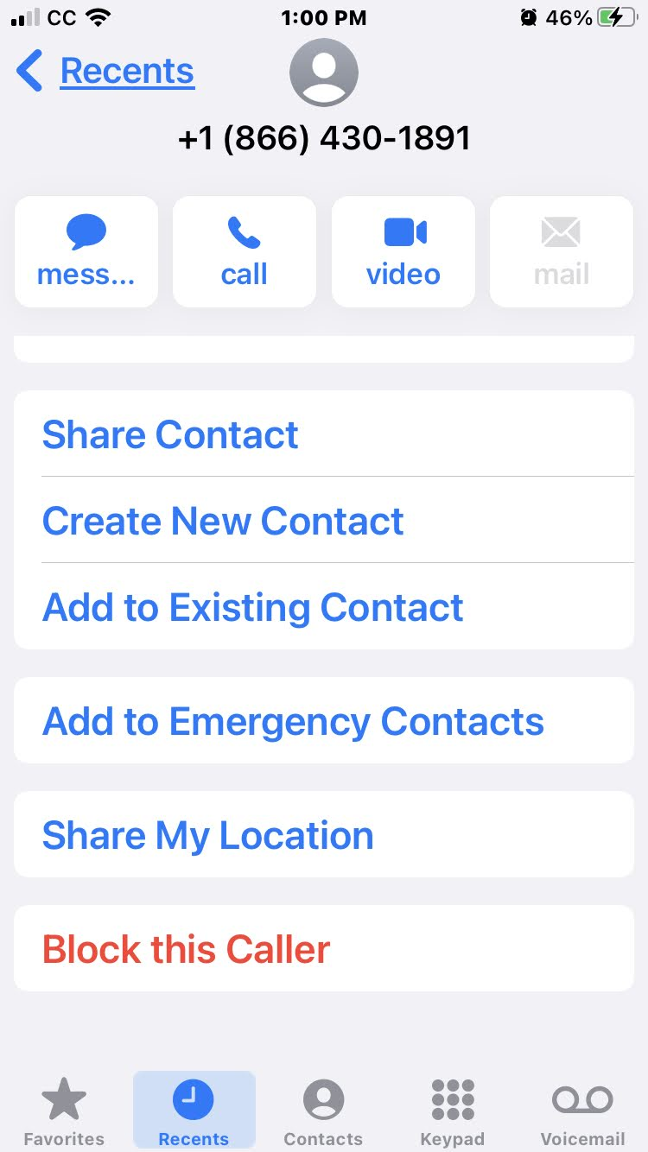
iPhone
Call blocking unwanted callers

Slide 5

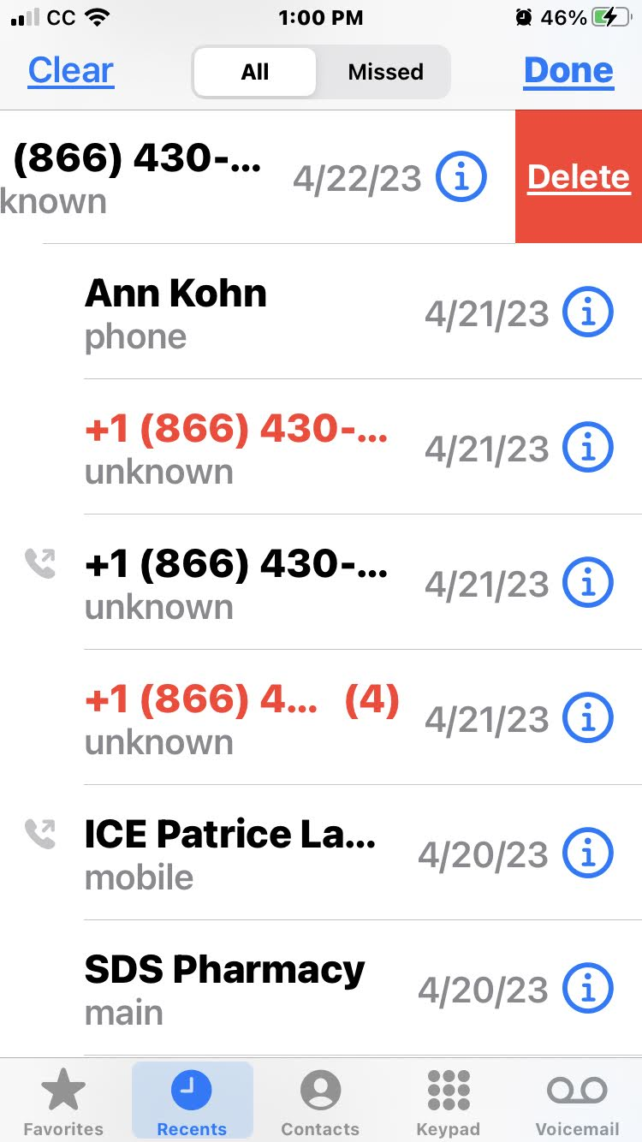
iPhone
Call blocking unwanted callers

Slide 6


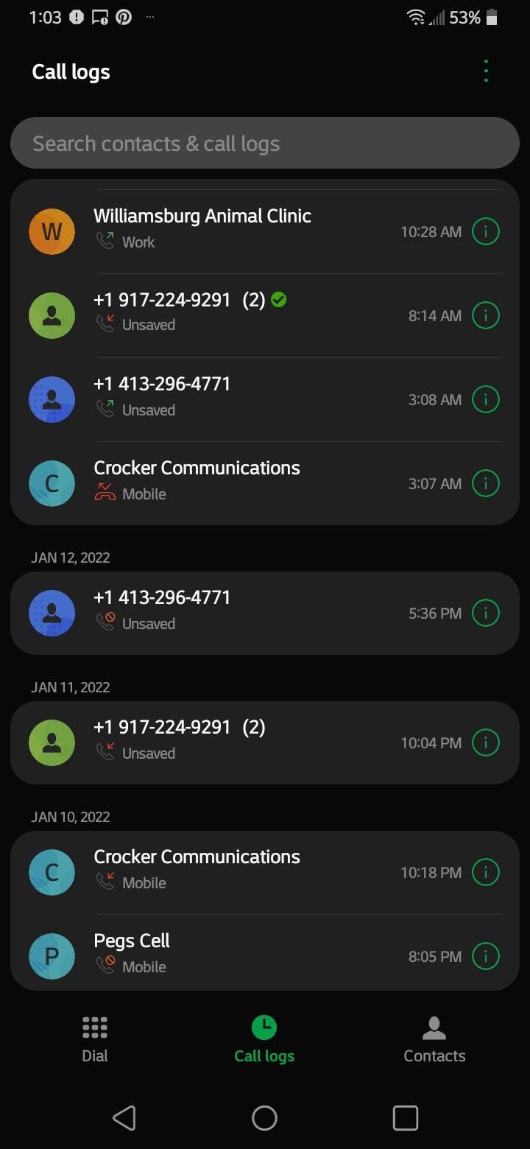
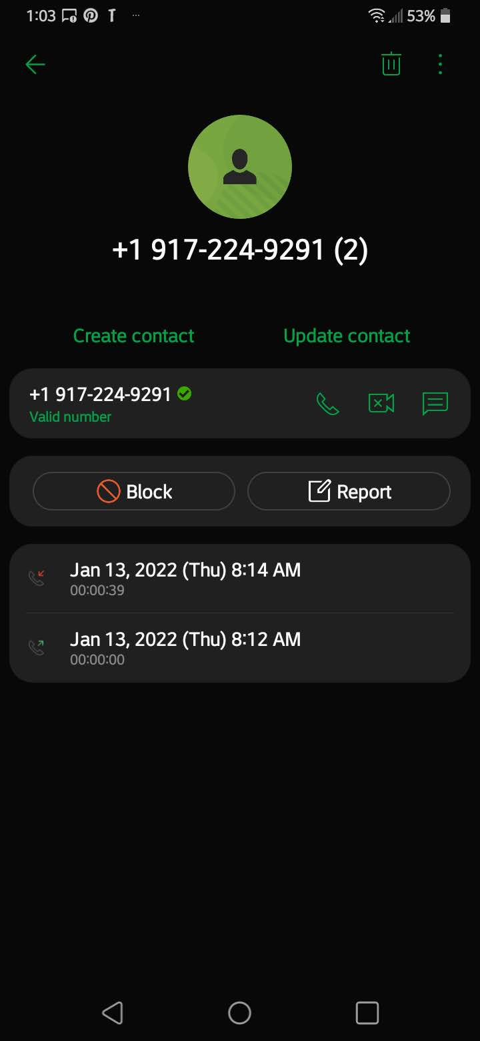
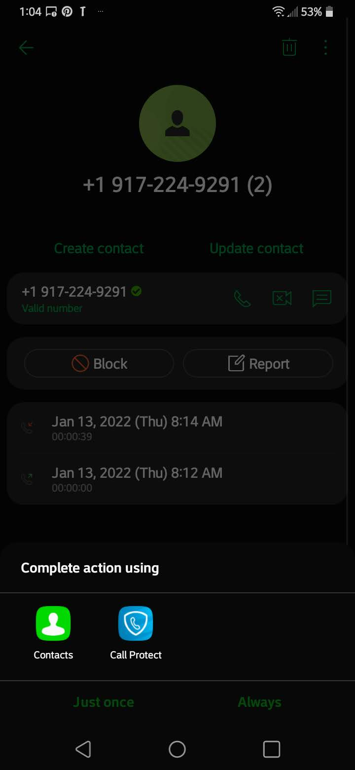
Android
Call blocking unwanted callers

Slide 7

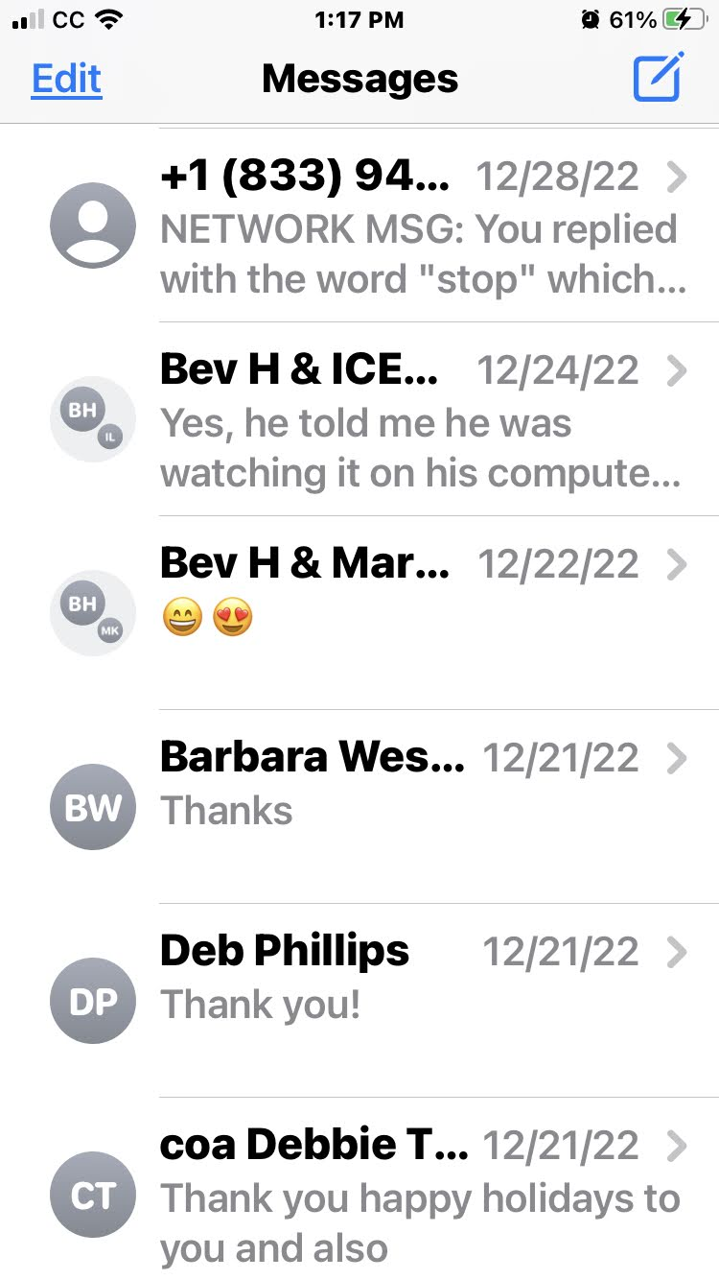
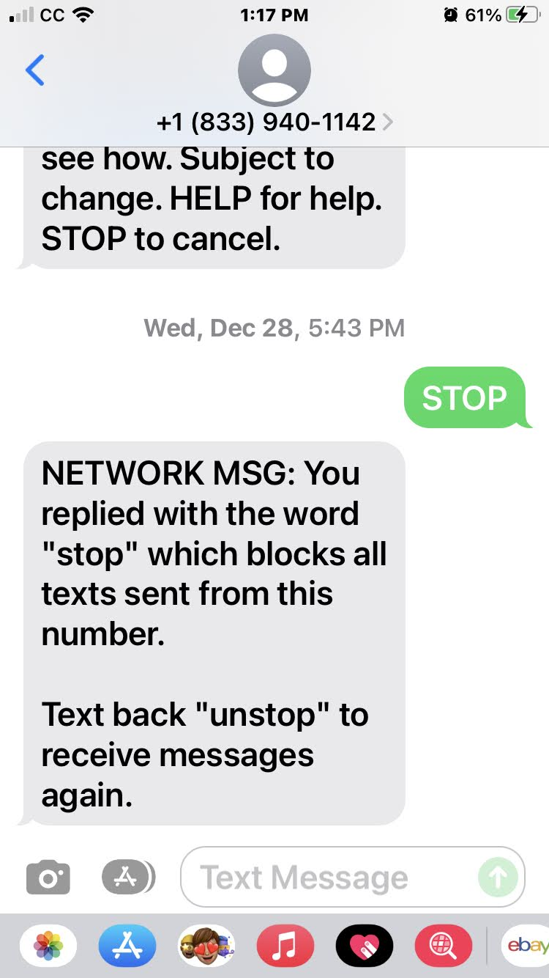
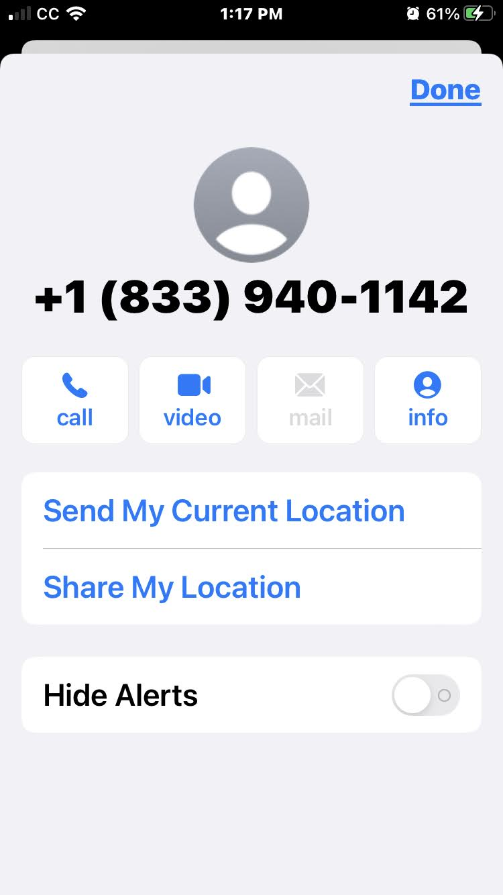
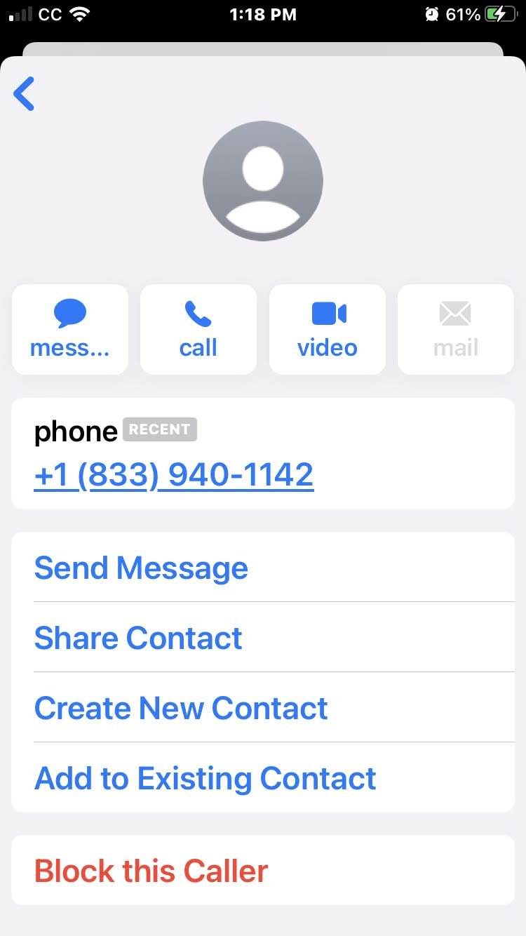
iPhone
Blocking Repeat Unwanted Texts

Slide 8
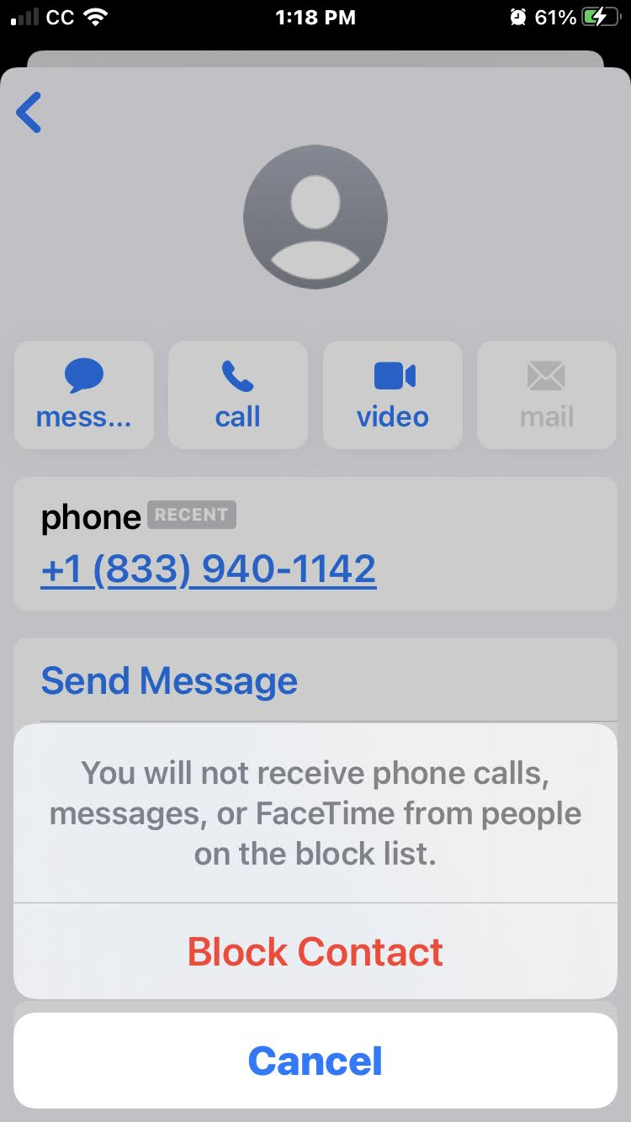
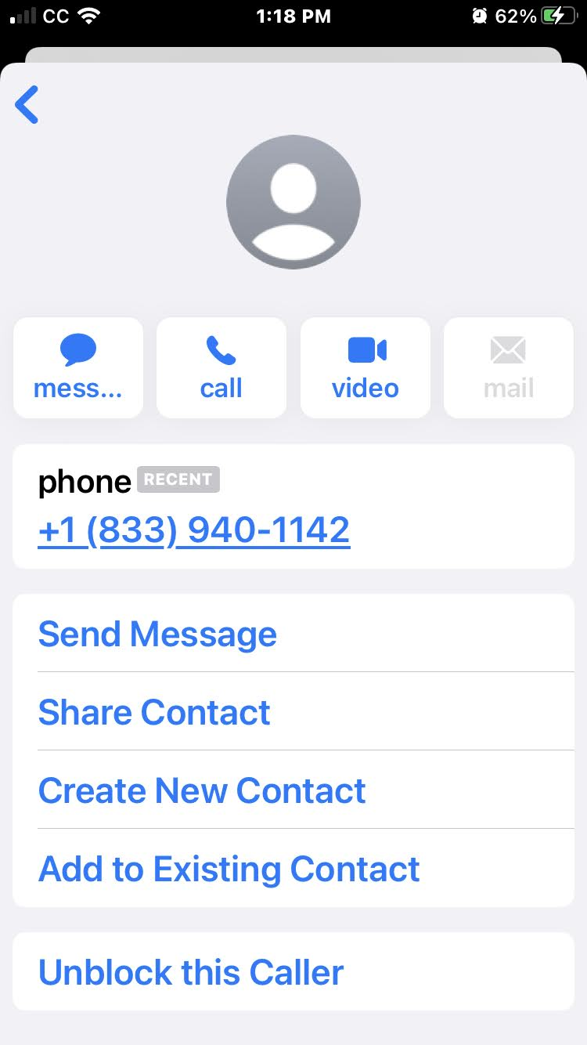
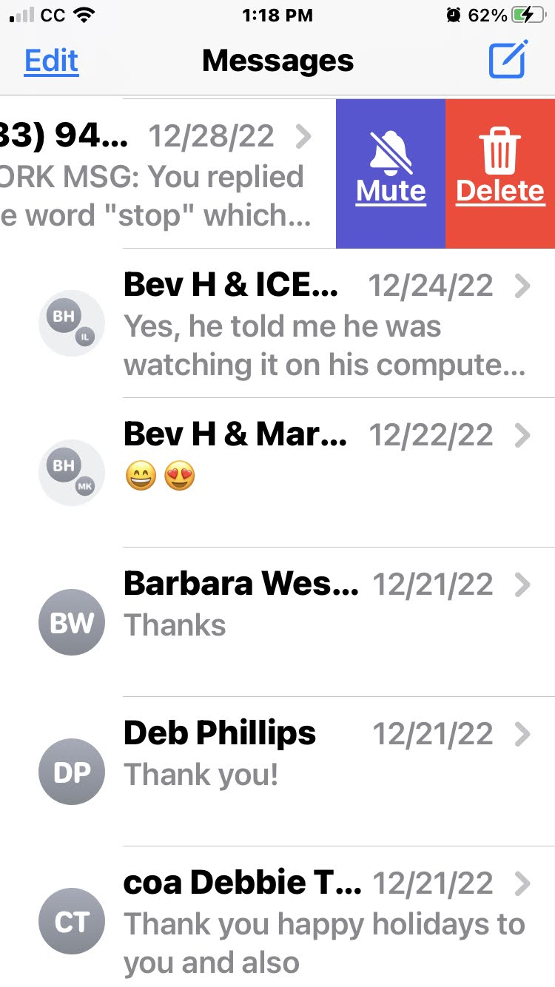
iPhone
Blocking Repeat Unwanted Texts

Slide 9

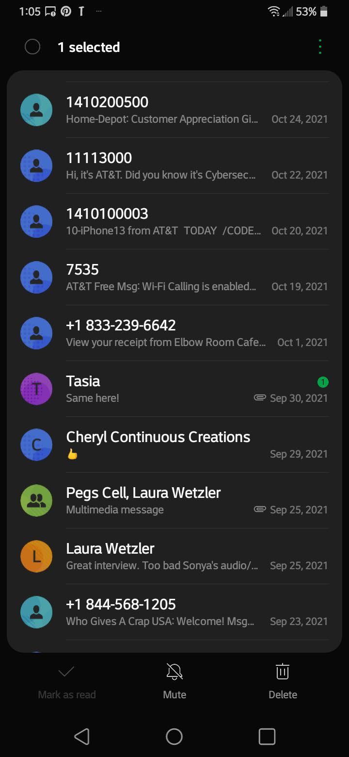
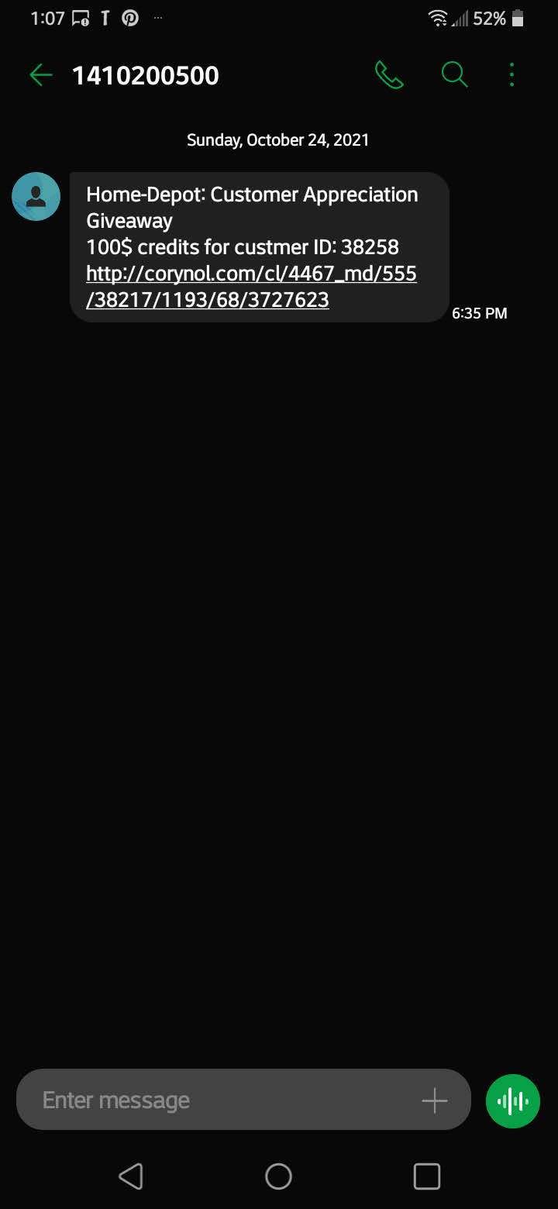
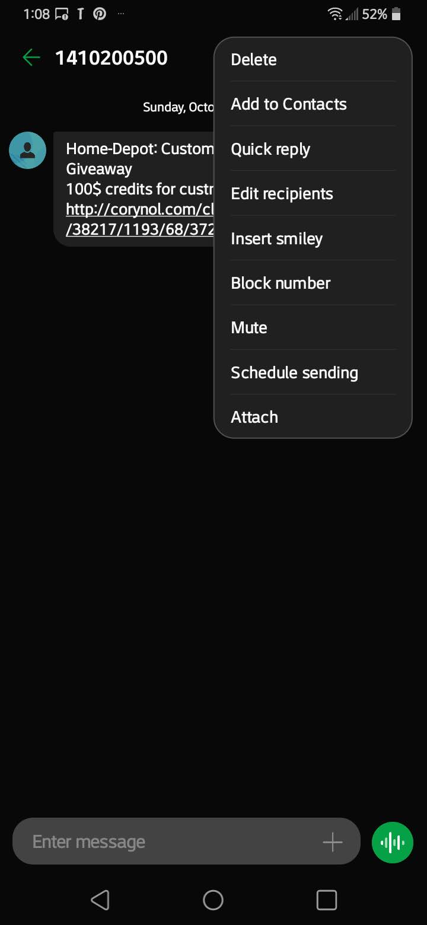
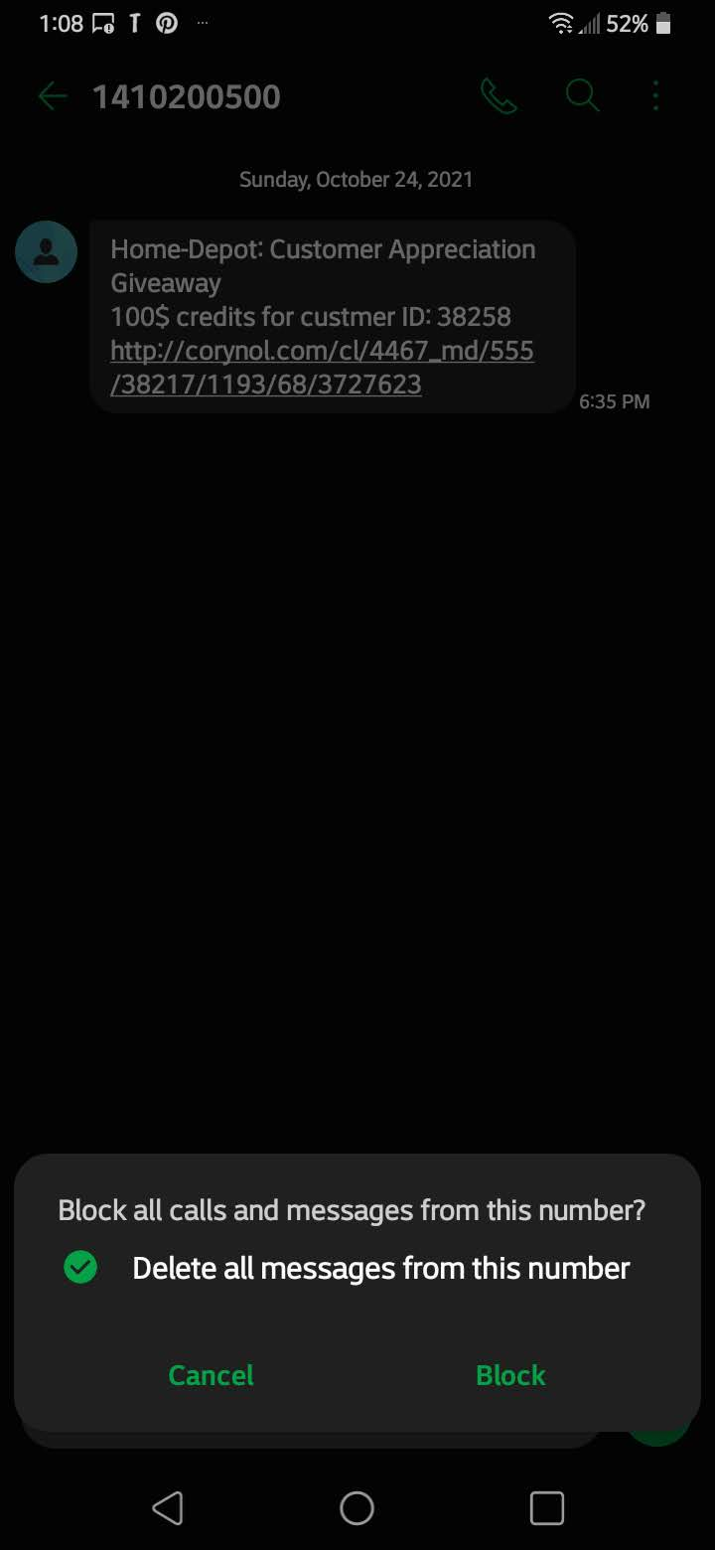
Android
Blocking unwanted text messages

Slide 10

Using the APP STORE

Slide 11
Using the APP STORE

Slide 12

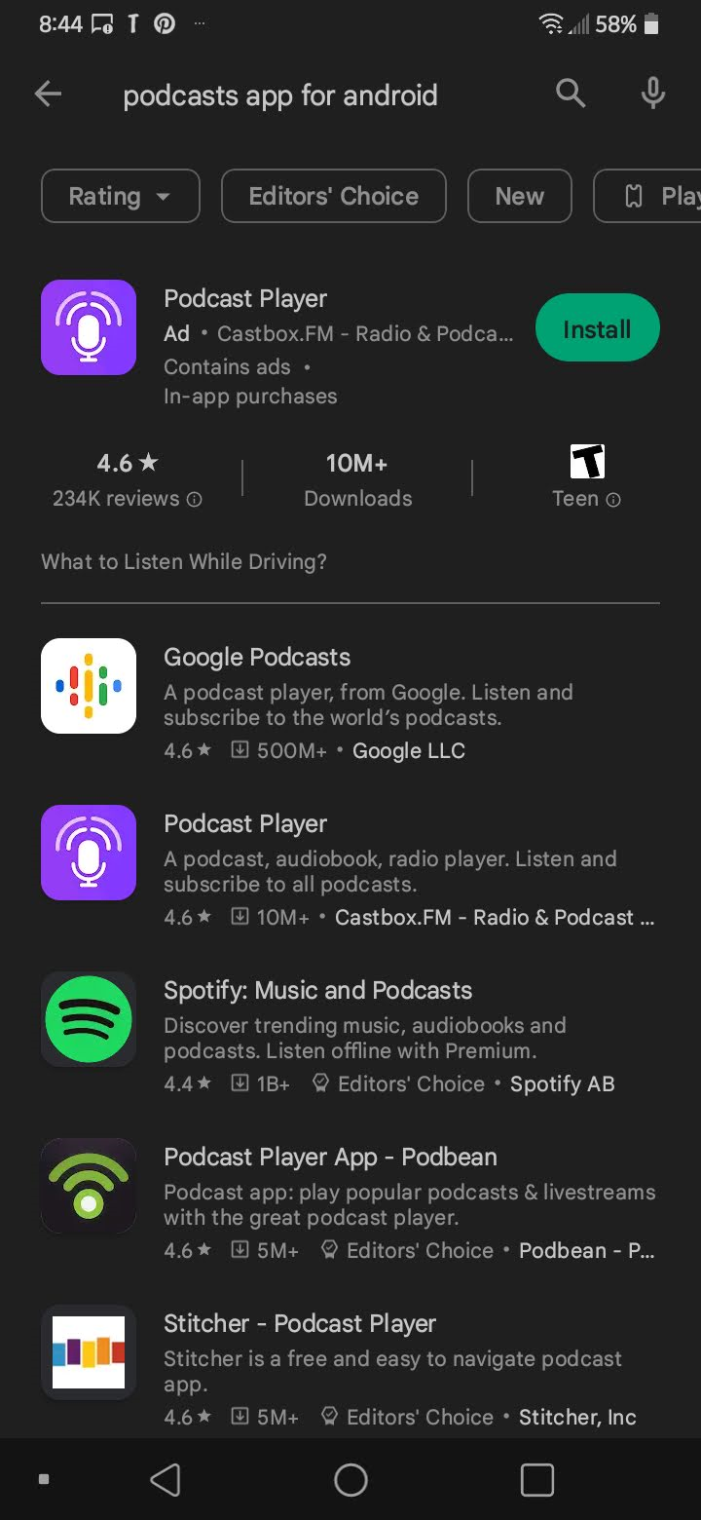
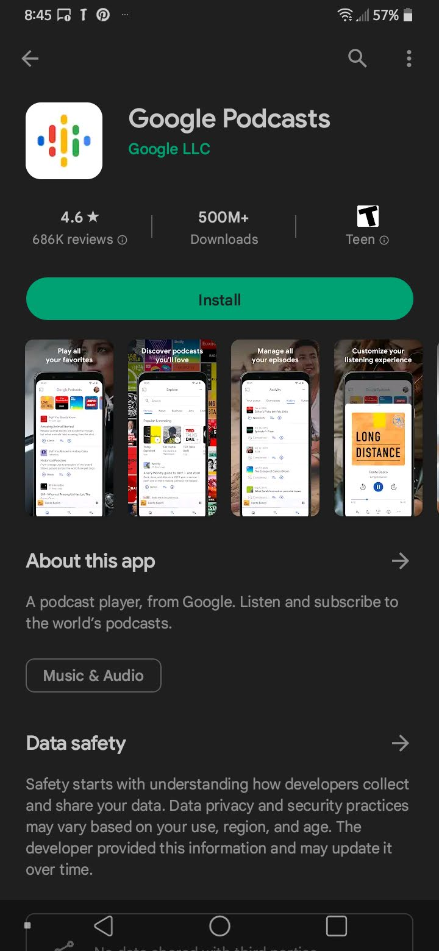
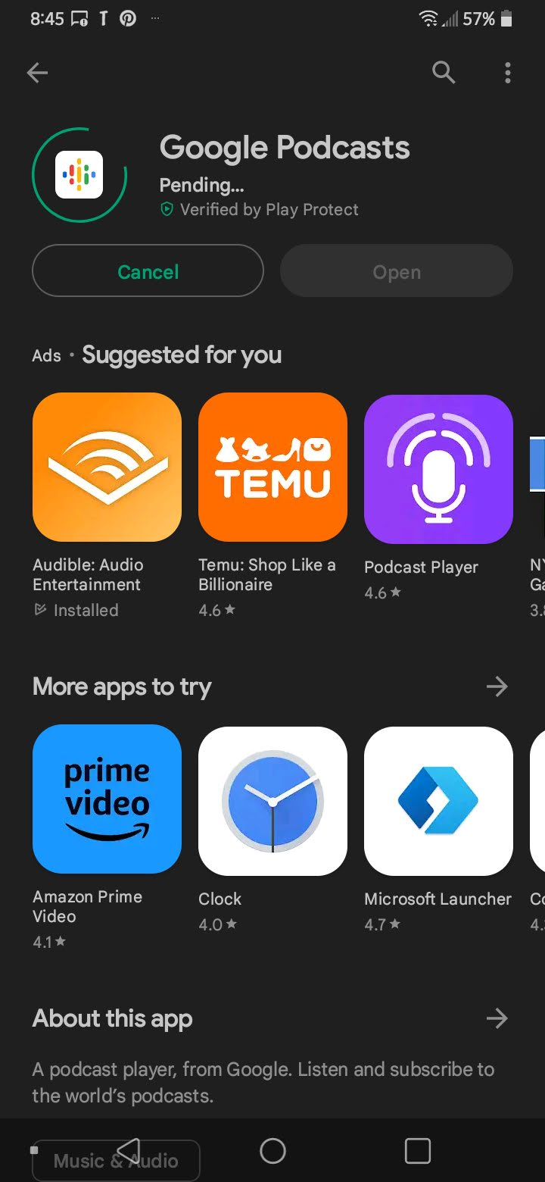
Play Store –
Finding Podcast Apps

Slide 13
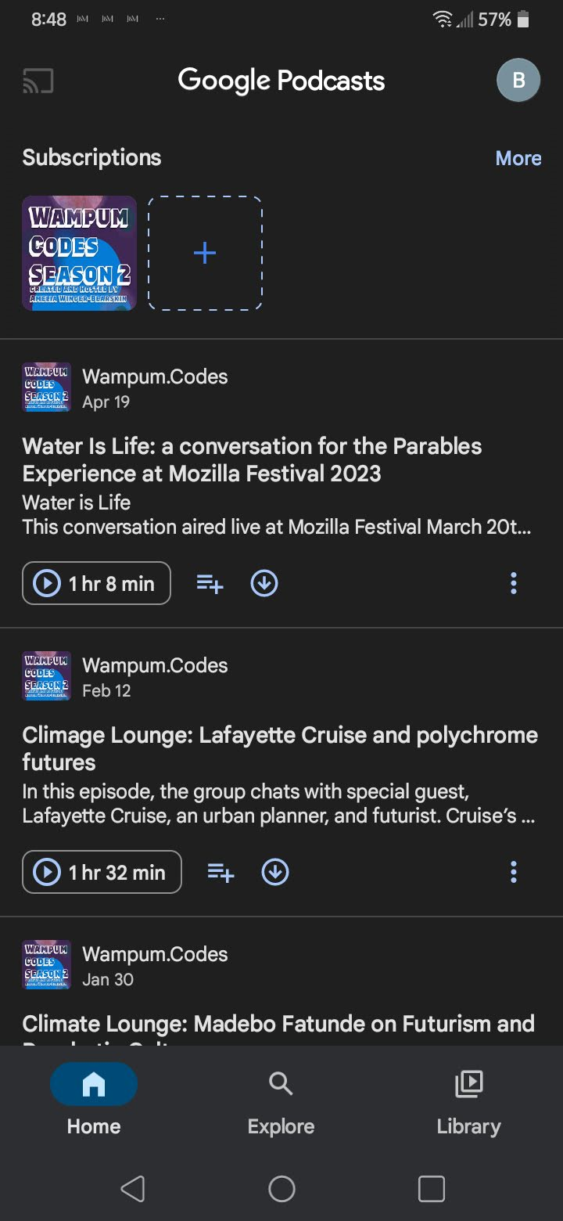
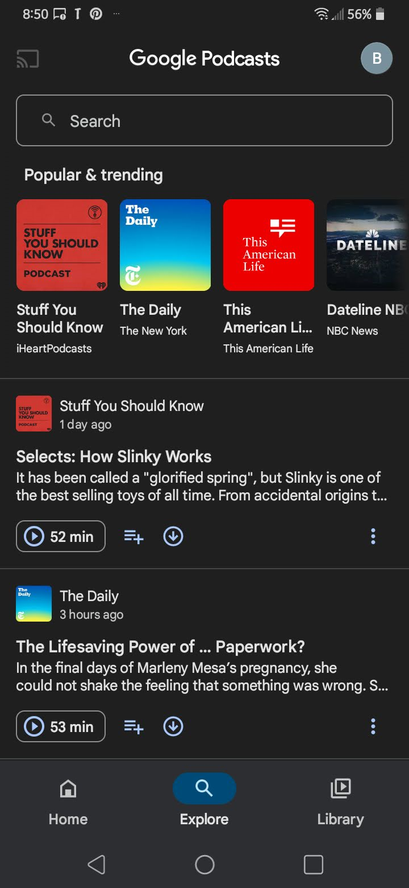
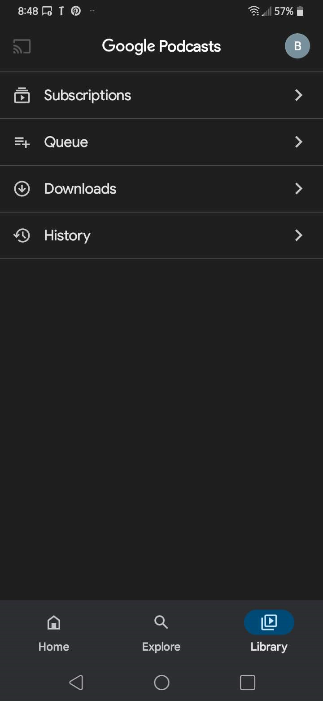
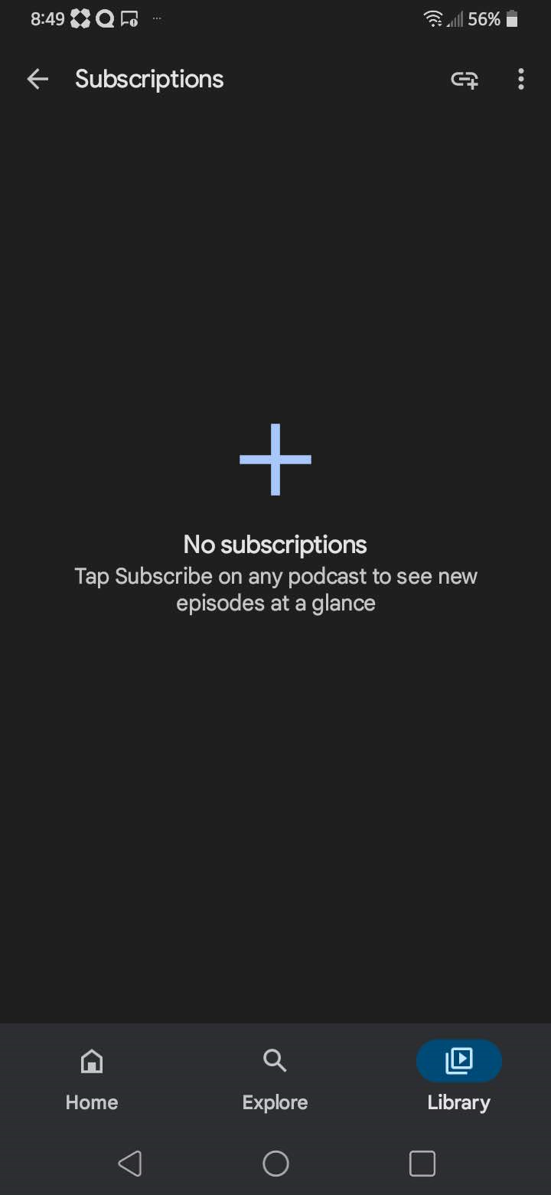
Using Google Podcasts

Slide 14
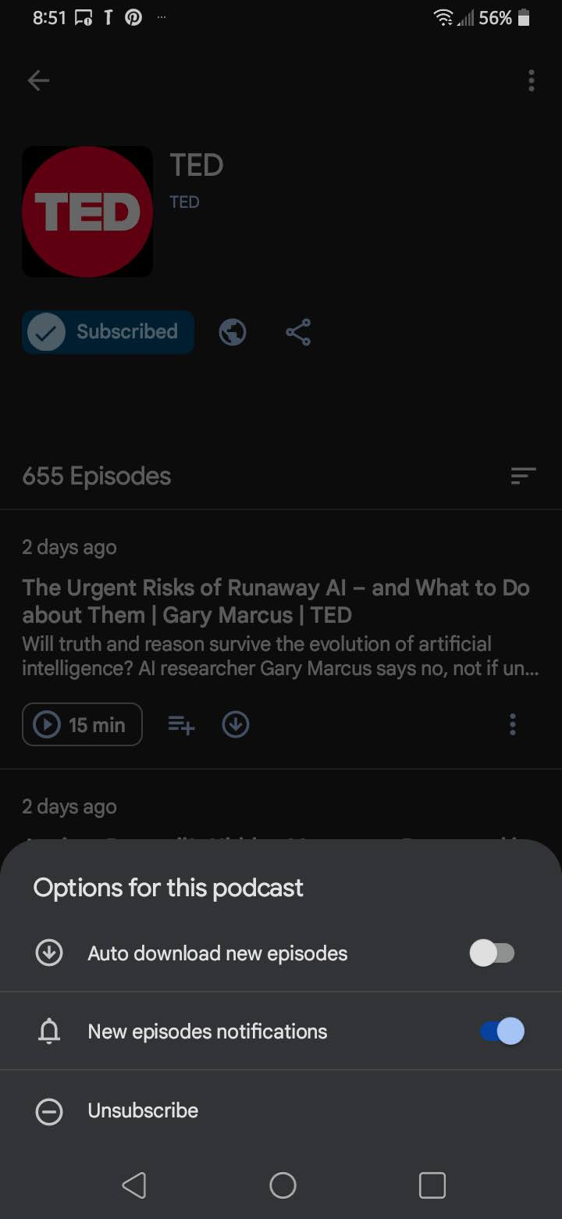
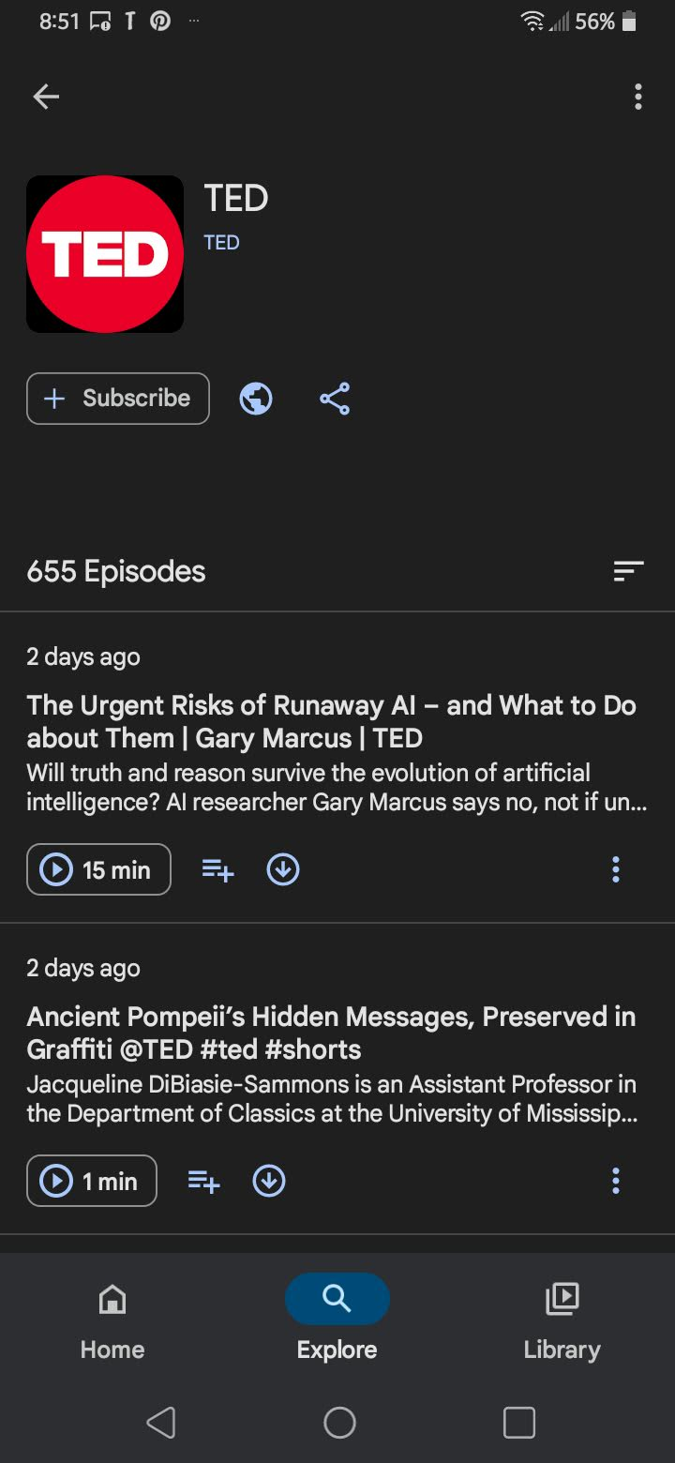
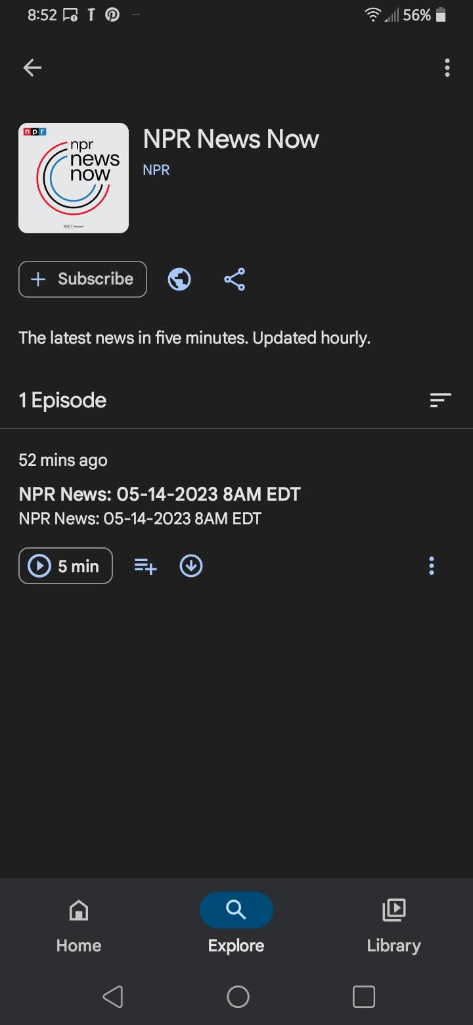
NAVIGATING – Google Podcasts

Slide 15

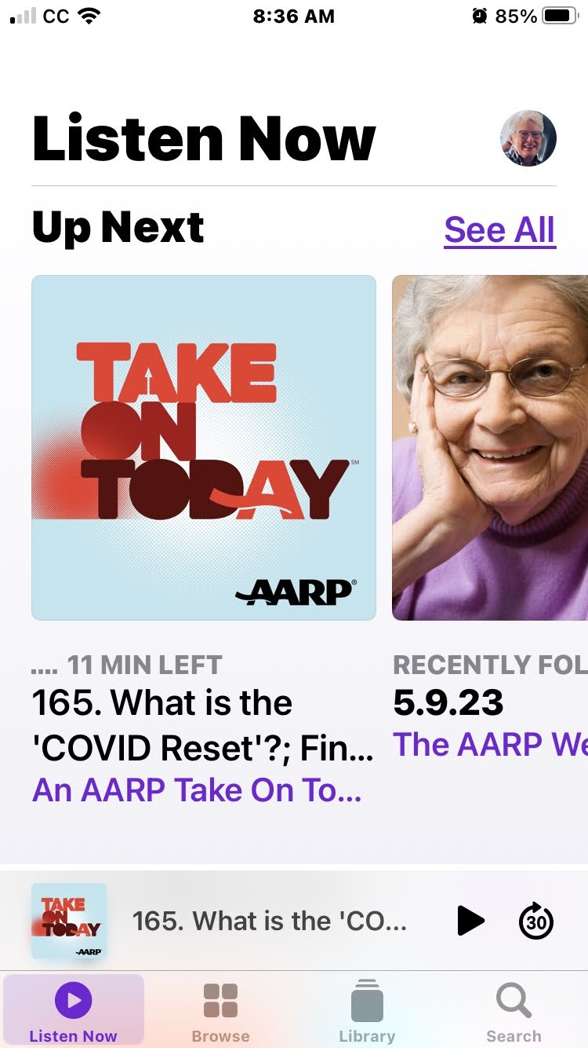
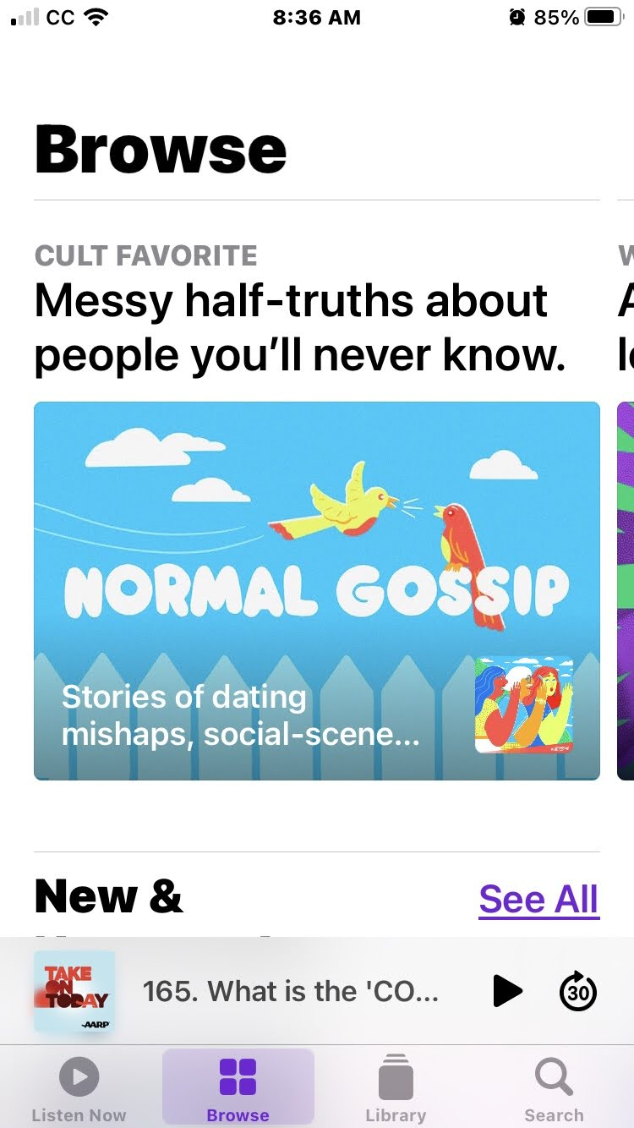
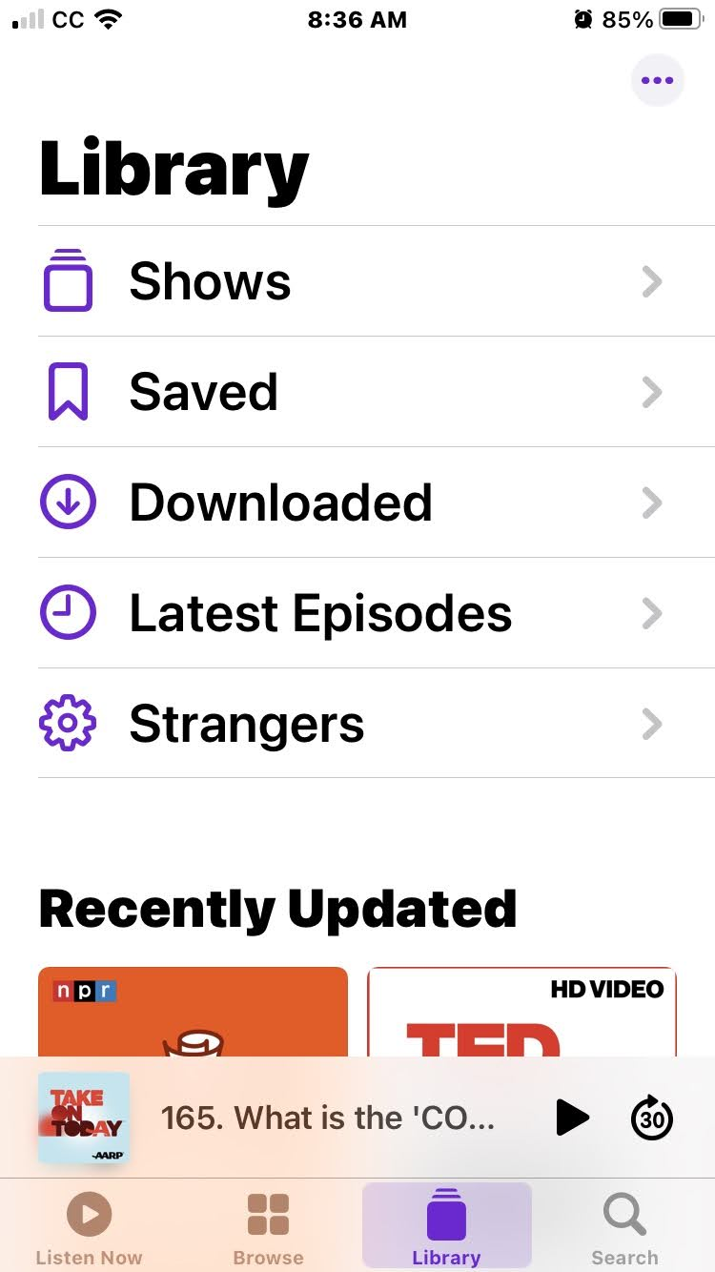
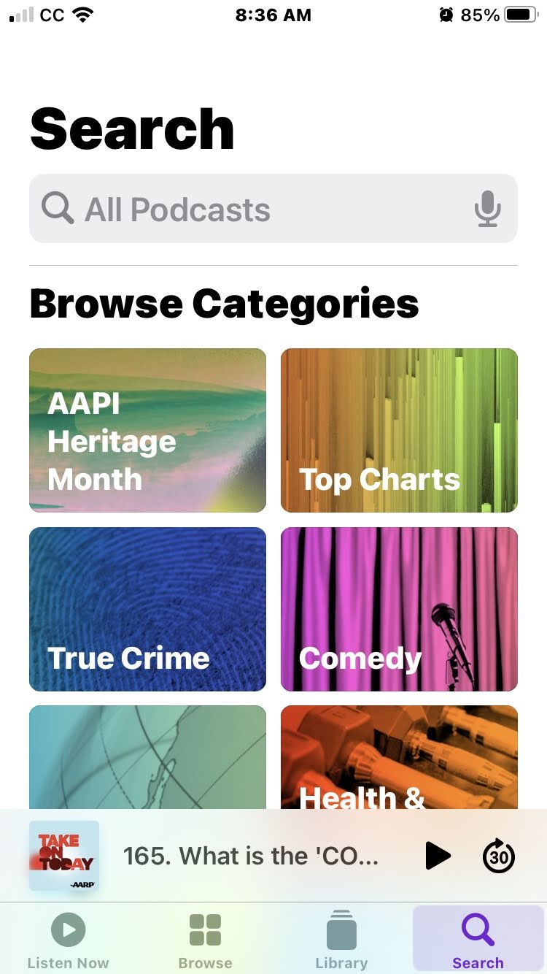
iPhone Podcasts

Slide 16
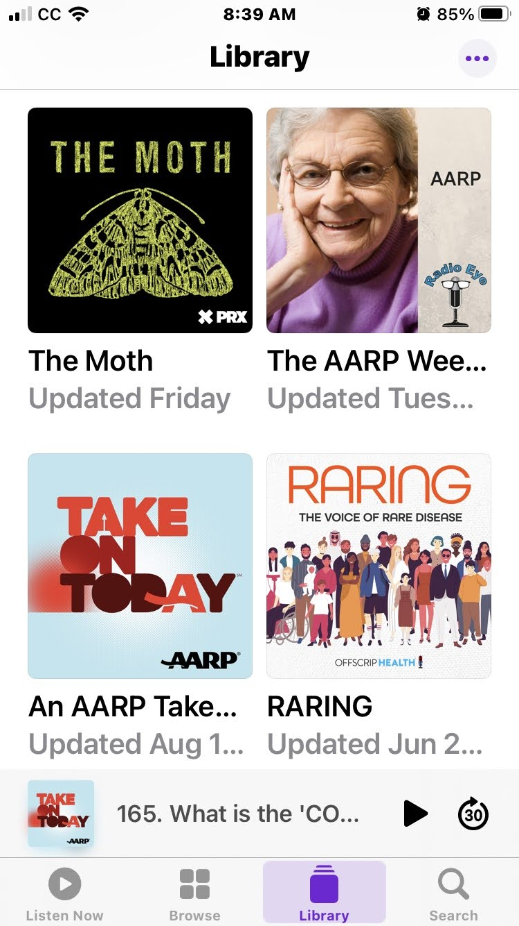
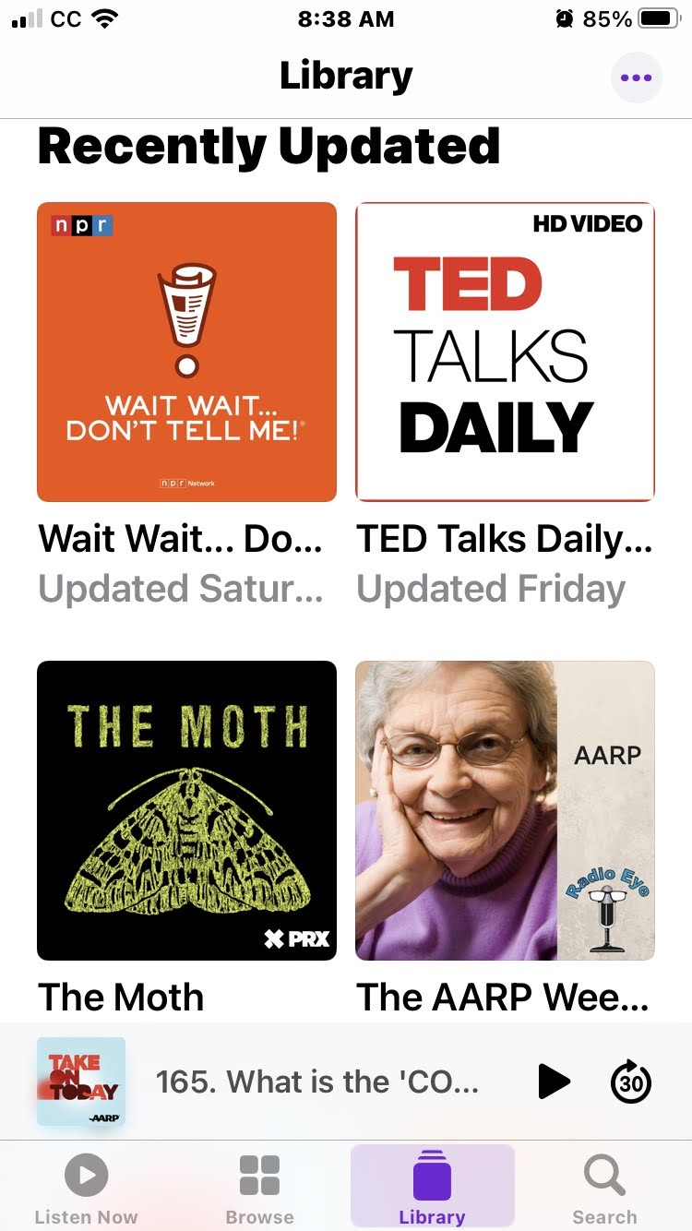
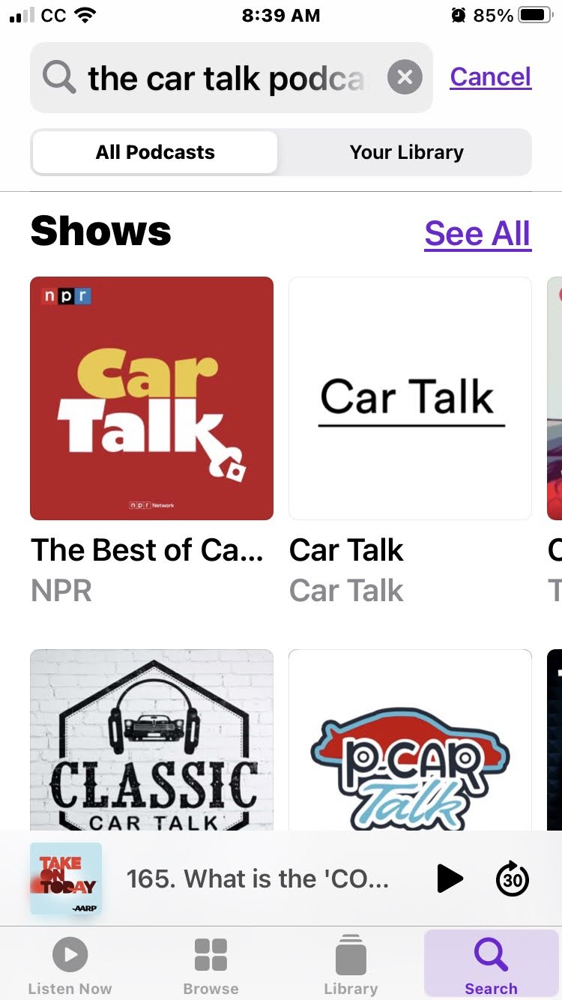
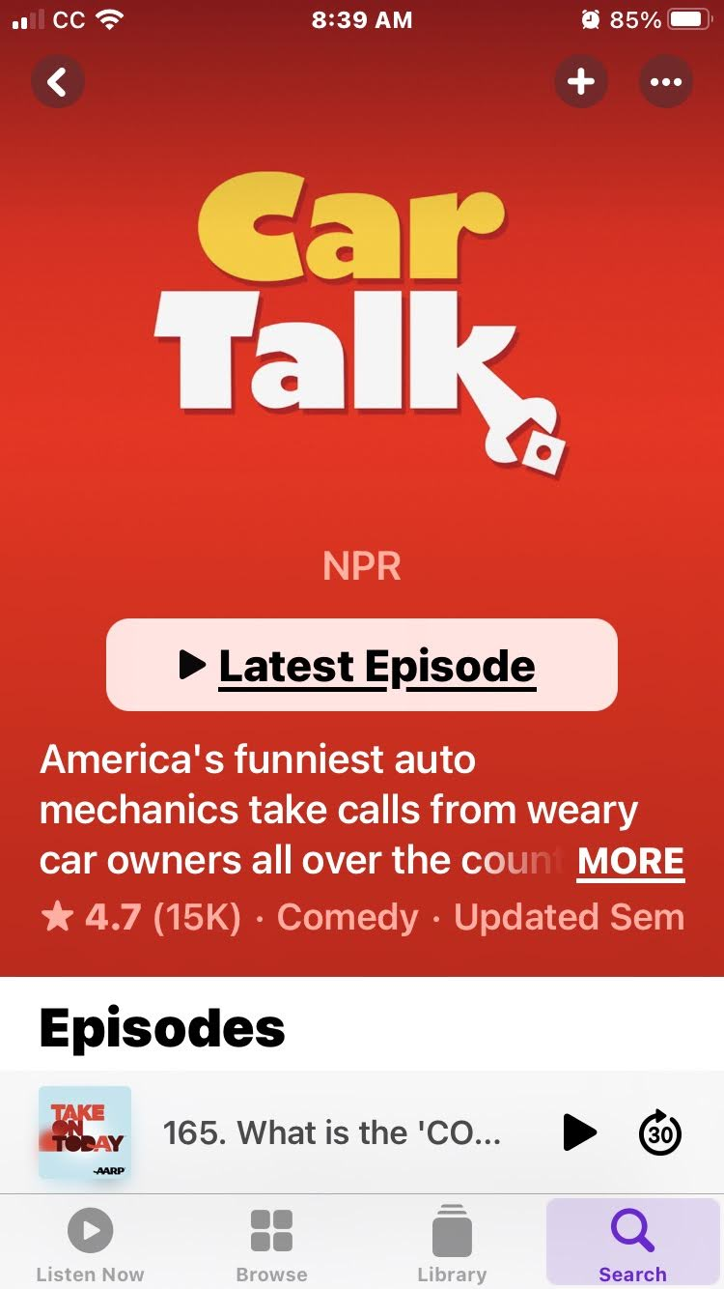
iPhone Podcasts

Slide 17
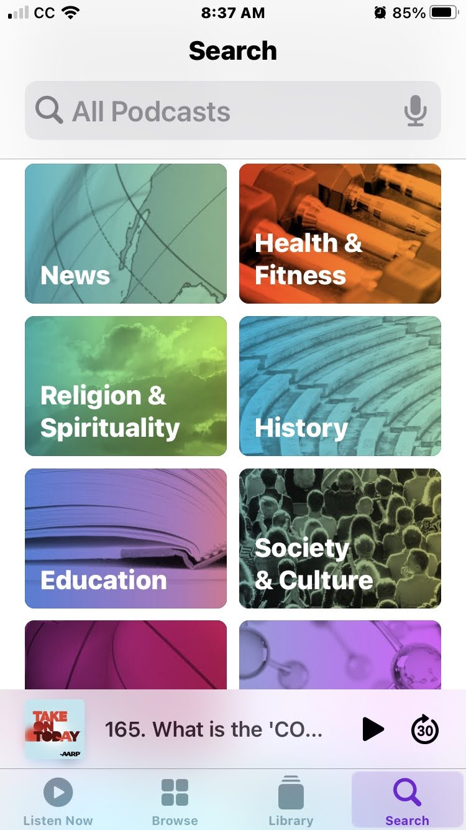
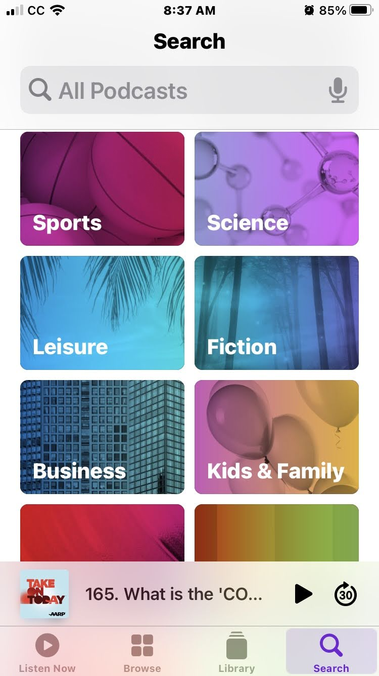
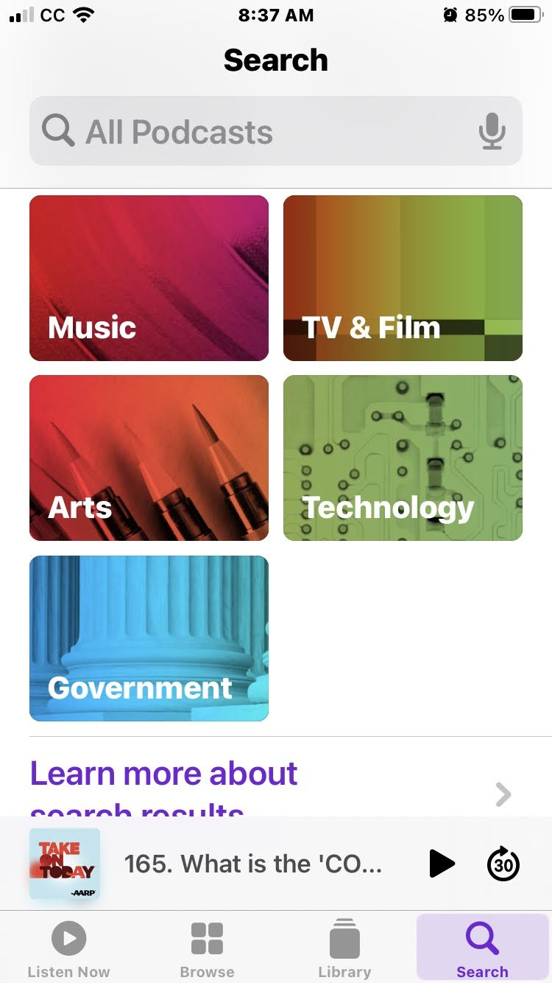
What topics are you interested in?

Slide 18




Android Podcasts Apps
Google Podcasts
Stitcher
Podcast Player
Spotify

Slide 19

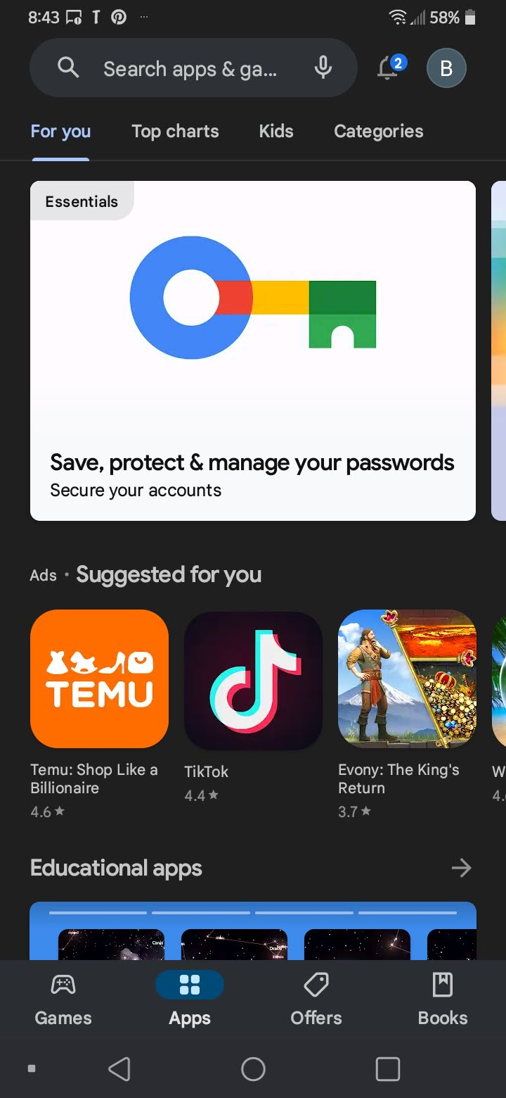



GOOGLE PLAY Store

Slide 20


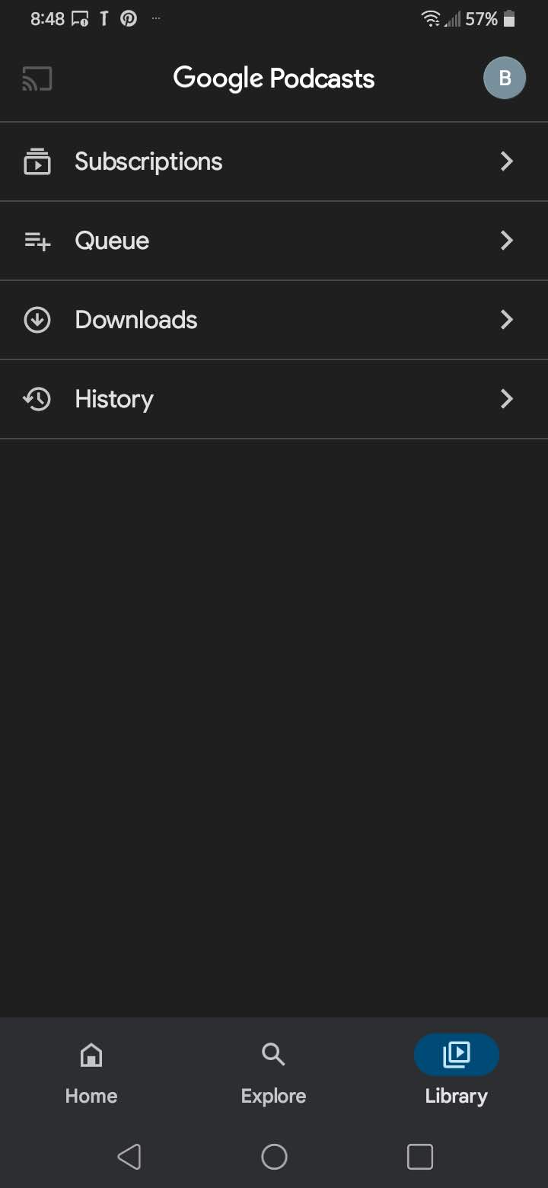

OPEN & EXPLORE GOOGLE PODCASTS

Slide 21
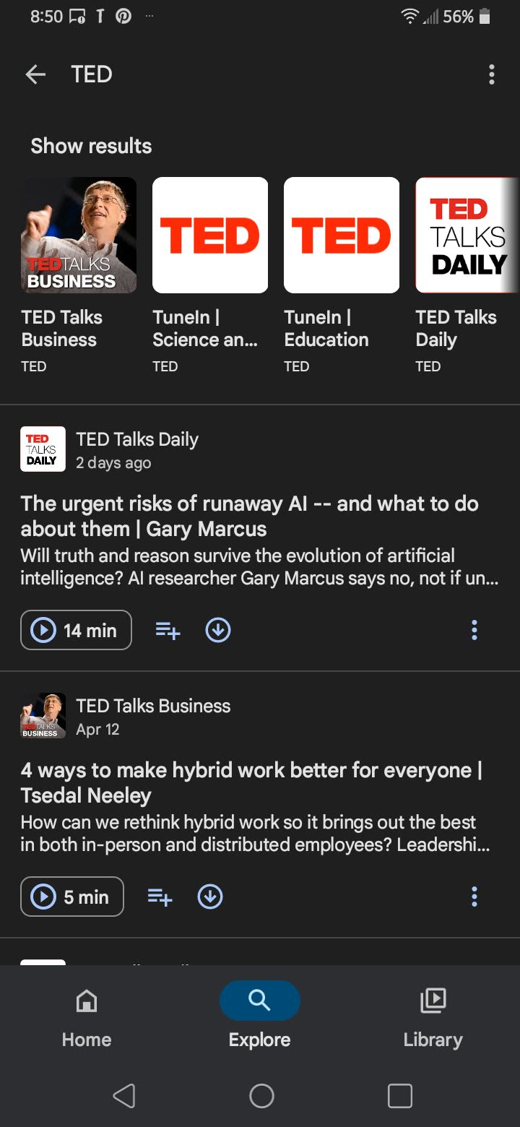

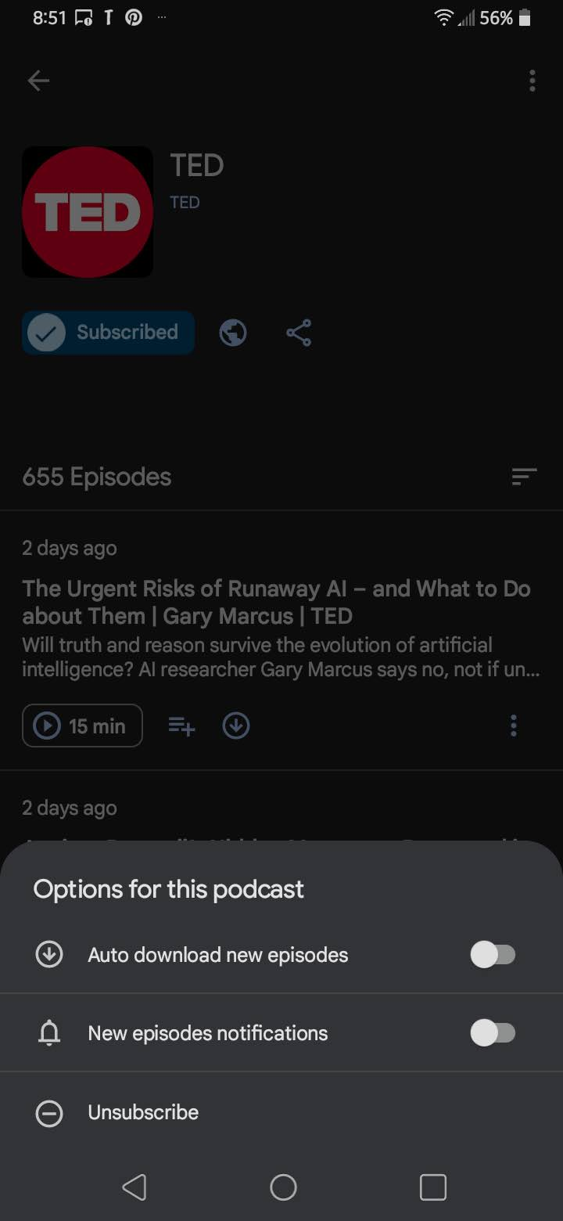
What’s TED Talks?
Technology, Education & Design

Slide 22


Listening to THE MOTH
The Moth's mission is to promote the art and craft of storytelling and to honor and celebrate the diversity and commonality of human experience.

Slide 23


QUESTIONS & IDEAS

